Slide 1
Windows Operating System
Presentation By : Summiya Zulfiqar
Aamir Bashir
Samra Fatima
Ali Raza
Operating system Presentation
MCS Final

Slide 2
INTRODUCTION
Windows OS, computer operating system (OS) developed by Microsoft Corporation to run personal computers (PCs). Featuring the first graphical user interface (GUI) for IBM-compatible PCs, the Windows OS soon dominated the PC market. Approximately 90 percent of PCs run some version of Windows.
The first version of Windows, released in 1985, was simply a GUI offered as an extension of Microsoft’s existing disk operating system, or MS-DOS. Based in part on licensed concepts that Apple Inc. had used for its Macintosh System Software, Windows for the first time allowed DOS users to visually navigate a virtual desktop, opening graphical “windows” displaying the contents of electronic folders and files with the click of a mouse button, rather than typing commands and directory paths at a text prompt.
Subsequent versions introduced greater functionality, including native Windows File Manager, Program Manager, and Print Manager programs, and a more dynamic interface. Microsoft also developed specialized Windows packages, including the networkable Windows for Workgroups and the high-powered Windows NT, aimed at businesses. The 1995 consumer release Windows 95 fully integrated Windows and DOS and offered built-in Internet support, including the World Wide Web browser Internet Explorer.

Slide 3
MEMORY MANAGEMENT
Memory management is the process of controlling and coordinating computer memory,
assigning portion called block to various running program to optimize overall system
performance. It resides in hardware in Operating System (OS), and in programs and
applications.
Unlike other operating system, windows perform so many sophisticated operations to be
done with its job. Memory involves process, threads and other underlying theory to
complete a command from users.
A memory is a physical device used to store some sequence of instructions. Now, this
memory can be two types- one is primary and the other one is secondary memory.
Primary memory is used for the information in physical systems which function at high
speed (i.e. RAM),as a distinction from secondary memory, which are physical devices
For program and data storage which are slow to access but offer higher memory
Capacity.

Slide 4
Primary memory is often associated with addressable semiconductor memory. There
are two main types of semiconductor memory: volatile and non-volatile (i.e. flash
memory)
Windows pretend as it is providing a flat virtual address space. But, in reality, there is a much smaller amount of physical memory. The hardware memory management in its of today’s microprocessors provides a way for the OS to map virtual address to physical address and it does this in the granularity of page.
The windows memory manager needs a demand paged virtual memory subsystem. Another way to explain is if we launch an application (e.g. Notepad), it doesn’t need to execute the entire Notepad, rather the application demands as it touches code pages, as it touches data pages, it’s at that point where the memory makes a connection between virtual memory and physical memory, reading in contents off disk as needed.
Proper management of memory is vital for every computer operating system. Modern advance operating system (e.g. windows) has adequate rules to allocate their memory to different task during execution of any program. Failure to obey these rules can lead to bugs, poor performance, and at worst case takeover by viruses and malicious software.

Slide 5
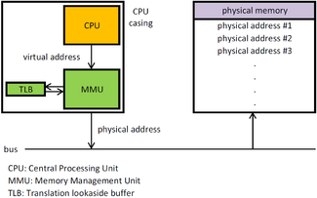

Slide 6
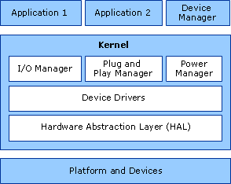
DEVICE MANAGEMENT
An Operating System manages device communication via their respective drivers. It does the following activities for device management.
Keeps tracks of all devices. Program responsible for this task is known as the I/O controller.
Decides which process gets the device
when and for how much time.
Allocates the device in the efficient way.
De-allocates devices.

Slide 7
The following functions are used in device management.
DeviceIoControl
Sends a control code directly to a specified device driver.
InstallNewDevice
Installs a new device. The user is prompted to select the device.
RegisterDeviceNotification
Registers the device or type of device for which a window will receive notifications.
UnregisterDeviceNotification
Closes the specified device notification handle.

Slide 8
PROCESSOR MANAGEMENT
A process contains its own independent virtual address space with both code and data, protected from other processes. Each process, in turn, contains one or more independently executing threads. A thread running within a process can execute application code, create new threads, create new independent processes, and manage communication and synchronization among the threads.
By creating and managing processes, applications can have multiple, concurrent tasks processing files, performing computations, or communicating with other networked systems. It is even possible to improve application performance by exploiting multiple CPU processors.
Windows Processes and Threads
Every process contains one or more threads, and the Windows thread is the basic executable unit; see the next chapter for a threads introduction. Threads are scheduled on the basis of the usual factors: availability of resources such as CPUs and physical memory, priority, fairness, and so on. Windows has long supported multiprocessor systems, so threads can be allocated to separate processors within a computer.

Slide 9
From the programmer’s perspective, each Windows process includes resources such as the following components:
One or more threads.
A virtual address space that is distinct from other processes’ address spaces. Note that shared memory-mapped files share physical memory, but the sharing processes will probably use different -virtual addresses to access the mapped file.
One or more code segments, including code in DLLs.
One or more data segments containing global variables.
Environment strings with environment variable information, such as the -current search path.
The process heap.
Resources such as open handles and other heaps.

Slide 10
Each thread in a process shares code, global variables, environment strings, and resources. Each thread is independently scheduled, and a thread has the following elements:
A stack for procedure calls, interrupts, exception handlers, and automatic storage.
Thread Local Storage (TLS)-An array like collection of pointers giving each thread the ability to allocate storage to create its own unique data environment.
An argument on the stack, from the creating thread, which is usually unique for each thread.
A context structure, maintained by the kernel, with machine register values.

Slide 11
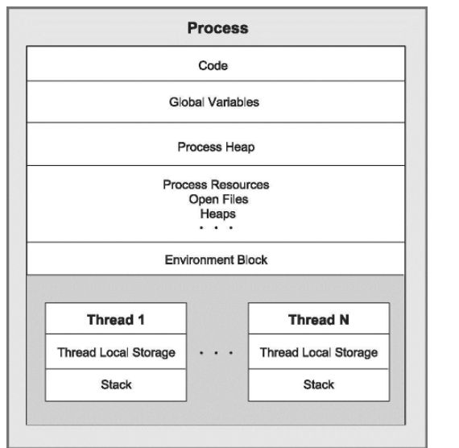
Figure 6-1 shows a process with several threads. This figure is schematic and does not indicate actual memory addresses, nor is it drawn to scale.

Slide 12
FILE MANAGEMENT
File Management is probably one of the most overlooked areas of the computer. Yet,
good File Management is critical for maintaining, protecting, and securing data.
A file object provides a representation of a resource (either a physical device or a
resource located on a physical device) that can be managed by the I/O system. Like
other objects, they enable sharing of the resource, they have names, they are protected
by object-based security, and they support synchronization. The I/O system also
enables reading from or writing to the resource.
Virtual Desks and Filing Cabinets :
Because the personal computer has always been designed with business in mind, file
management is based on the "desk" analogy-imagine that the computer is like a desk at
which you work.

Slide 13
Files :
The data file is the basic building block in which you organize information on the computer. Like a paper file, a data file can hold text or images, but it can really hold any information that a program writes to it.
The general rule is that a file created by a program always needs that same program to read and edit it again. There are exceptions to this rule, though, since many programs have functionality to open files created by other software. For example, the Microsoft Word (a word processor), can read not only files created by Word, but also text files, files created by certain versions of other word processors, certain types of image files, and HTML files.
File extensions in Windows :
To distinguish between the different types of files, Windows adds a certain code to the end of a file name. Traditionally, this code is three characters long (though it can be longer), and the letters offer some description as to the type of file. For example, a file created by Microsoft Word ends with .doc, indicating that it is a Word document.
Every program is likely to save its own proprietary file format, but there are also some universal formats that have a greater likelihood of being read by many different applications. The following table introduces a few of these file types along with their extension.

Slide 14
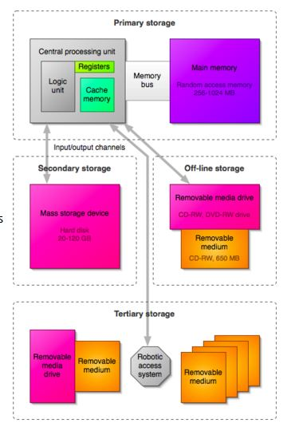
File management isn't all about
Manipulating files.
There is a certain amount of preventative
maintenance you should perform on your
computer, and especially your hard drive to ensure that the data is kept safe from loss.
The three things you should practice regularly to keep your data safe are backup, defragment, and disk scans.

Slide 15
SECURITY
Security refers to providing a protection system to computer system resources such as
CPU, memory, disk, software programs and most importantly data/information stored in
the computer system. If a computer program is run by an unauthorized user, then
he/she may cause severe damage to computer or data stored in it. So a computer
system must be protected against unauthorized access, malicious access to system
memory, viruses, worms etc. We're going to discuss following topics in this chapter.
Authentication
One Time passwords
Program Threats
System Threats
Computer Security Classifications
Authentication
Authentication refers to identifying each user of the system and associating the
executing programs with those users. It is the responsibility of the Operating System to
create a protection system which ensures that a user who is running a particular
program is authentic. Operating Systems generally identifies/authenticates users using
following three ways .

Slide 16
Username / Password − User need to enter a registered username and password with Operating system to login into the system.
User card/key − User need to punch card in card slot, or enter key generated by key generator in option provided by operating system to login into the system.
User attribute - fingerprint/ eye retina pattern/ signature − User need to pass his/her attribute via designated input device used by operating system to login into the system.
One Time passwords
One-time passwords provide additional security along with normal authentication. In One-Time Password system, a unique password is required every time user tries to login into the system. Once a one-time password is used, then it cannot be used again. One-time password are implemented in various ways.
Random numbers − Users are provided cards having numbers printed along with corresponding alphabets. System asks for numbers corresponding to few alphabets randomly chosen.
Secret key − User are provided a hardware device which can create a secret id mapped with user id. System asks for such secret id which is to be generated every time prior to login.
Username / Password − User need to enter a registered username and password with Operating system to login into the system.
User card/key − User need to punch card in card slot, or enter key generated by key generator in option provided by operating system to login into the system.
User attribute - fingerprint/ eye retina pattern/ signature − User need to pass his/her attribute via designated input device used by operating system to login into the system.
One Time passwords
One-time passwords provide additional security along with normal authentication. In One-Time Password system, a unique password is required every time user tries to login into the system. Once a one-time password is used, then it cannot be used again.
Program Threats
Operating system's processes and kernel do the designated task as instructed. If a user program made these process do malicious tasks, then it is known as Program Threats. One of the common example of program threat is a program installed in a computer which can store and send user credentials via network to some hacker.

Slide 17
System Threats
System threats refers to misuse of system services and network connections to put user in trouble. System threats can be used to launch program threats on a complete network called as program attack. System threats creates such an environment that operating system resources/ user files are misused.
Computer Security Classifications
As per the U.S. Department of Defense Trusted Computer System's Evaluation Criteria there are four security classifications in computer systems: A, B, C, and D. This is widely used specifications to determine and model the security of systems and of security solutions. Following is the brief description of each classification.
Type A :
Highest Level. Uses formal design specifications and verification techniques. Grants a high degree of assurance of process security.

Slide 18
2. Type B :
Provides mandatory protection system. Have all the properties of a class C2 system. Attaches a sensitivity label to each object. It is of three types.
B1 − Maintains the security label of each object in the system. Label is used for making decisions to access control.
B2 − Extends the sensitivity labels to each system resource, such as storage objects, supports covert channels and auditing of events.
B3 − Allows creating lists or user groups for access-control to grant access or revoke access to a given named object.
3. Type C :
Provides protection and user accountability using audit capabilities. It is of two types.
C1 − Incorporates controls so that users can protect their private information and keep other users from accidentally reading / deleting their data. UNIX versions are mostly Cl class.
C2 − Adds an individual-level access control to the capabilities of a Cl level system.
4. Type D :
Lowest level. Minimum protection. MS-DOS, Window 3.1 fall in this category.

Slide 19
CONTROL OVER SYSTEM PERFORMANCE
Performance troubleshooter
The first thing that you can try is the Performance troubleshooter, which can automatically find and fix problems. The Performance troubleshooter checks issues that might slow down your computer's performance, such as how many users are currently logged on to the computer and whether multiple programs are running at the same time.
Limit how many programs run at startup
Many programs are designed to start automatically when Windows starts. Software manufacturers often set their programs to open in the background, where you can't see them running, so they'll open right away when you click their icons. That's helpful for programs you use a lot, but for programs you rarely or never use, this wastes precious memory and slows down the time it takes Windows to finish starting up. Decide for yourself if you want a program to run at startup.
Clean up your hard disk
Unnecessary files on your hard disk take up disk space and can slow down your computer. Disk Cleanup removes temporary files, empties the Recycle Bin, and removes a variety of system files and other items that you no longer need.

Slide 20
Defragment your hard disk
Fragmentation makes your hard disk do extra work that can slow down your computer. Disk Defragmenter rearranges fragmented data so your hard disk can work more efficiently. Disk Defragmenter runs on a schedule, but you can also defragment your hard disk manually.
Run fewer programs at the same time
Sometimes changing your computing behavior can have a big impact on your PC's performance. If you're the type of computer user who likes to keep eight programs and a dozen browser windows open at once—all while sending instant messages to your friends don't be surprised if your PC bogs down. Keeping a lot of e‑mail messages open can also use up memory.
Check for viruses and spyware
If your PC is running slowly, it's possible that it's infected with a virus or spyware. This is not as common as the other problems, but it's something to consider. Before you worry too much, check your PC using antispyware and antivirus programs.

Slide 21
JOB ACCOUNTING
JOB :
In certain computer operating systems, a job is the unit of work that a computer operator (or
a program called a job scheduler) gives to the operating system.
For example, a job could be the running of an application program such as a weekly payroll program. A job is usually said to be run in batch (rather than interactive) mode. The operator or job scheduler gives the operating system a "batch" of jobs to do (payroll, cost analysis, employee file updating, and so forth) and these are performed in the background when time-sensitive interactive work is not being done. In IBM mainframe operating systems (MVS, OS/390, and successors) a job is described with job control language (JCL). Jobs are broken down into job steps. An example of a job step might be to make sure that a particular data set or database needed in the job is made accessible.
Typically, the development programmer who writes a program that is intended to be run as a batch job also writes the JCL that describes for the operating system how to run the job (for example, what data sets or databases it uses). The use of a job scheduler usually provides greater flexibility and the ability to monitor and report batch job operations.
A similar term is task, a concept usually applied to interactive work. A multitasking operating system serving one or more interactive users can at the same time perform batch jobs in the background.

Slide 22
ERROR DETECTING
OS provides error detecting aids for production of traces, errors messages, bugs, dumps and so on.
Error Detection
In networking, error detection refers to the techniques used to detect noise or other impairments introduced into data while it is transmitted from source to destination. Error detection ensures reliable delivery of data across vulnerable networks.
Error Control
In information theory and coding theory with applications in computer science and telecommunication, error detection and correction or error control are techniques that enable reliable delivery of digital data over unreliable communication channels.
Error Correcting
code memory (ECC memory) is a type of computer data storage that can detect and correct the most common kinds of internal data corruption. ECC memory is used in most computers where data corruption cannot be tolerated under any circumstances, such as for scientific or financial computing

Slide 23
COORDINATION BETWEEN OTHER SOFTWARES AND USERS
TL/DR: the operating system uses a scheduler. The main goal of an operating system (OS) is to provide usable hardware abstractions to software. For example, you might know about a thing called a file. This is one of the abstractions that most OS provide. The hardware provides a disk drive of some kind, and the OS refines this by managing files on the disk. For software cooperation, the OS does the same abstraction work with the hardware's processor (or CPU). This means that every program running on this OS will have the impression of running alone (like it gets all the CPU for itself). In practice, the OS has something called a scheduler. The job of the scheduler is to allocate a slice of CPU time for each program. Once the time is up, the scheduler will switch to executing another program (this is called a context switch). A context switch is usually transparent to the program, so that the program doesn't know it is being interrupted. There are many variations around schedulers, and even if it's an old problem to implement a one, there is still much research work on their performance nowadays.

Slide 24
Providing interface User interface controls how you input data and instruction and how information is displayed on a monitor.
The following are the operating systems interfaces
Graphical-line interface:
This is an interface that works at the point of contact between a computer and its user, and which employs graphic.
Command-line interface:
is a user interface to a computer's operating system or an application in which the user responds to a visual prompt by typing in a command on a specified line which is related to an intended course of action.

